Slide 1
Fuel price prediction
Mohammed thanish A
FullStack Developer(python)

Slide 2

INTRODUCTION
🔸 Purpose: Predict fuel prices using machine learning to help users plan better and reduce fuel expenses.
🔸The fuel price prediction system aims to forecast fuel prices using historical data and machine learning models.
It is essential for helping individuals, businesses, and policymakers plan for fuel expenses with rising global fuel prices, accurate predictions can mitigate financial risk. This project employs Python to analyze trends and provide price estimates efficiently.

Slide 3
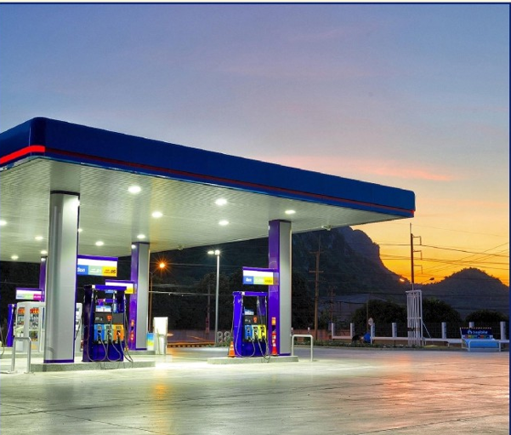
EXISTING SYSTEM
Fuel expenses are tracked manually using notebooks or Excel sheets. This method is prone to errors and lacks consistency.
No personalized system based on fuel or vehicle type. Users get no insights into their own consumption patterns.
Average and total fuel expenses are not calculated automatically. Manual calculations waste time and may be inaccurate.
Limited ability to update or correct past records. Users often re-write or lose earlier data.
No integration of analytics or data trends. Existing systems don’t provide long-term insights.

Slide 4
CHALLENGES IN EXISTING SYSTEM
No structured format for data storage and retrieval. ➤ Makes tracking and updating records difficult.
Manual effort needed to calculate totals and averages. ➤ Increases workload and reduces accuracy.
No support for different vehicle or fuel types. ➤ Ignores user-specific data and needs.
Cannot compare daily/monthly fuel usage easily. ➤ No analytical or graphical support provided.
Not suitable for predictive analysis or future planning. ➤ Static data gives no smart suggestions or forecasts.

Slide 5
PROPOSED SYSTEM
A Python-based app to manage fuel records and calculations. Stores and retrieves fuel data using object-oriented modules.
Supports both 2-wheeler and 4-wheeler vehicle types. Each type has custom mileage and base pricing.
Includes options for petrol and diesel vehicles. Fuel-type-specific discounts and mileage considered.
Calculates price per litre, total cost, and averages. Automatically reflects user’s fuel usage pattern.
Provides a user-friendly menu interface on the console. Allows real-time input, update, and viewing of records.

Slide 6
Features of pROPOSEd SYSTEM
Add and update fuel records with date and litre input. ➤ Validates entries and prevents duplicate data.
Tracks total fuel spent and average price per litre. ➤ Helps users budget their fuel expenses effectively.
Custom discount logic applied for different litre slabs. ➤ Dynamic pricing based on usage level.
Stores fuel type for each entry (Petrol/Diesel). ➤ Useful for hybrid vehicle comparisons.
Easy-to-navigate command-line interface. ➤ Ensures non-technical users can use it smoothly.

Slide 7
SYSTEM MODULES
Vehicle Module – Manages type, fuel, mileage, and base price. ➤ Initializes settings based on user input.
FuelData Module – Tracks and stores daily fuel usage. ➤ Adds, updates, and displays fuel history.
Discount Logic – Calculates price/litre after discounts. ➤ Varies based on litres filled and vehicle type.
Analytics Module – Calculates total cost and average price. ➤ Provides summary insights to the user.
User Interface Module – Menu for user interaction. ➤ Takes input and connects all modules together.

Slide 8
FUTURE ENCHANCEMENTS
Integrate real-time fuel price APIs from official sources. ➤ Makes system dynamic and location-specific.
Add data visualization using libraries like Matplotlib. ➤ Shows charts for monthly spending and trends.
Implement machine learning for price prediction. ➤ Uses historical data to forecast future prices.
Add database support (SQLite or MySQL). ➤ Stores data permanently beyond runtime.
Build a web/mobile app using Python frameworks. ➤ Increases user accessibility and usability.

Slide 9
system architecture / technology stack
Language Used: Python 3.x ➤ Chosen for its simplicity, readability, and flexibility.
Object-Oriented Programming (OOP) ➤ Classes and methods manage vehicle and fuel logic.
In-Memory Data Storage ➤ Uses Python dictionaries to store fuel records temporarily.
Console-Based User Interface ➤ Menu-driven interface using input() and print() functions.
Modular Code Structure ➤ Separation of concerns via different Python classes.

Slide 10
CONCLUSION
This fuel price prediction system will help users forecast fuel prices with higher accuracy. By utilizing machine learning and real-time data, the system overcomes limitations of current approaches. The proposed solution provides a more reliable and scalable method for predicting fuel prices. In the future, the system can be expanded to include additional features and better precision.

Slide 11
FUEL PRICE PRIDECTION
PROGRAM

Slide 12
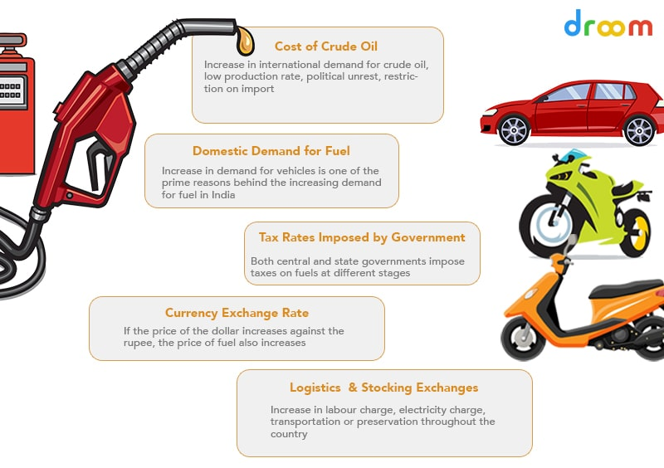
OUTPUT: vehicle selection
Enter city name: Coimbatore
Enter vehicle type (2-wheeler/4-wheeler): 2-wheeler
Enter fuel type (petrol/diesel): petrol
[i] Selected 2-Wheeler (Petrol) with mileage 50 km/l

Slide 13
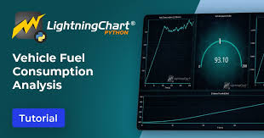
OUTPUT: add fuel record
Enter date (YYYY-MM-DD): 2025-05-10
Enter number of litres: 3
[+] Added for 2025-05-10: ₹90.00/litre, 3.00 litres (Petrol) (Total ₹270.00)

Slide 14
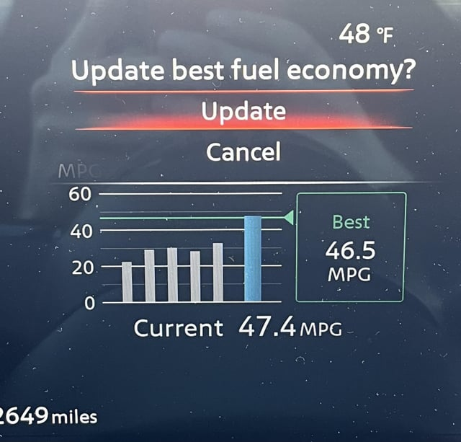
OUTPUT: UPDATE FUEL RECORDS
Enter date to update (YYYY-MM-DD): 2025-05-10
Enter updated number of litres: 4
[~] Updated 2025-05-10: ₹85.00/litre, 4.00 litres (Petrol) (Total ₹340.00)

Slide 15

OUTPUT: VIEW ALL RECORDS
--- Fuel Data for Coimbatore ---
2025-05-10: ₹85.00/litre, 4.00 litres (Petrol)

Slide 16
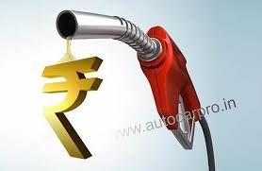
OUTPUT: VIEW TOTAL FUEL COST
[i] Total amount spent on fuel: ₹340.00

Slide 17
Thank you

